Slide 1

Getting started with the amazon DOT and alexa voice services
Dave Brock May 04, 2017

Slide 2



AGENDA
What is the Amazon Echo/Dot?
Who is Alexa?
Getting to know Alexa
Assessing the Creepy Factor
Demo
Extending your device with skills
Getting started with Alexa development
User interaction model
Working through the sample application
Technically complex content (Nerd Score) based on maximum of four Screeches
Notes:
We’ll be having varying technical complexity in this talk, but everyone should be able to enjoy the content.

Slide 3
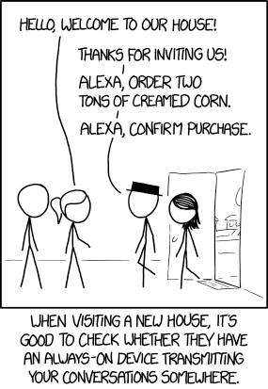

Slide 4
WHAT IS THE AMAZON ECHO/DOT?
Simply, a natural language, voice interface “personal assistant” device
Hands-free, always on, with wi-fi and Bluetooth
The Amazon Echo is a stand-alone speaker with immersive audio
The Dot is the smaller device with the same software capabilities, which can be optionally connected with a speaker

Slide 5
WHAT (OR WHO) IS ALEXA?
Alexa is the voice service that powers your Amazon devices. The Amazon hardware devices are simply an interface to the Alexa Voice Service, which can be found on most Amazon devices and most third-party integrations
The Alexa name was chosen because of the hard ‘X’ consonant, leading to higher precision. It also is a reference to the Library of Alexandria, one of the largest and most significant libraries of the ancient world
When you develop against AVS, your application can be run anywhere Alexa is supported!

Slide 6
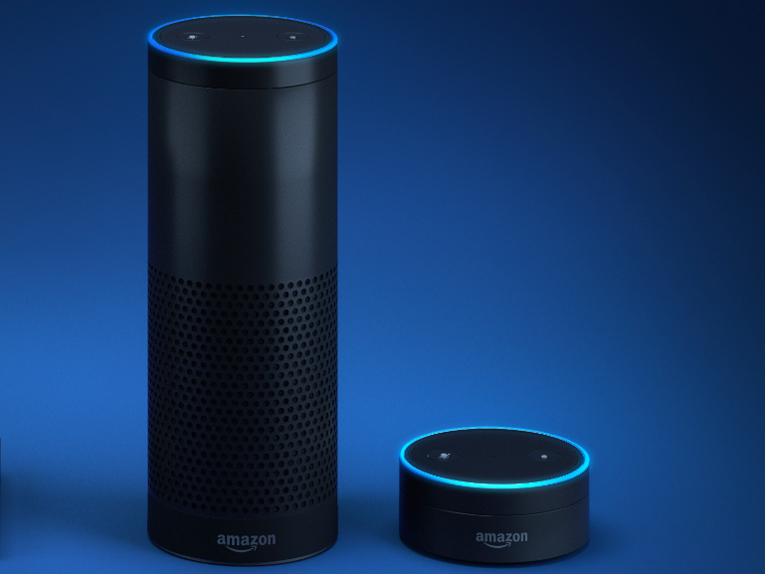
Getting to know alexa
The app allows you to view your recent commands, specify settings, manage your alarms, music, shopping lists, and more
You can turn on Alexa using a specified wake word: Alexa, Echo, Amazon, or Computer. The wake word can be changed using the Alexa app on your phone or tablet.
Just say your wake word, and Alexa starts listening

Slide 7
ASSESSING THE CREEPY FACTOR: Alexa is always on
Whenever you make a voice request, Alexa devices record audio clips of what you say, which are sent to the server to formulate a response. These clips are associated to your account (and accessible in Settings > History in your Alexa app)
Alexa is then listening to you, even when you’re not making a request—these conversations are kept locally and not stored or sent over a network
The audio zipping from your location to Amazon’s data centers is fully encrypted. A bigger risk is someone getting a hold of your Amazon account information
Still freaked out? There are many push-button alternatives
https://www.wired.com/2016/12/alexa-and-google-record-your-voice/

Slide 8
DESPITE WHAT YOU MAY HAVE HEARD…

Slide 9

Remember, THE CLOUD IS JUST SOMEONE ELSE’S COMPUTER

Slide 10
So, what can alexa do? A DEMO
Play music
Check calendar and dates
News and sports
Alarms
Timers
Tasks
Traffic and weather
Shopping
Control device
Communicate with other devices
Tell jokes
Math
Nearby restaurants and nightlife
Movie listings, information, showtimes
Play audiobooks
Order an Uber
Order pizza
IoT commands
Search
Make Amazon purchases
Wikipedia

Slide 11
Extending your amazon device with skills
Alexa can do great things out of the box but the power is in the platform that showcases its third-party skills. Some examples:
Capital One – check your balance or make a payment
Opening Bell – stock prices (‘Alexa, ask Opening Bell for the price of Apple’)
Text messaging
Airport security line wait times
Kayak – (‘Alexa, ask Kayak where I can go for $500?’)
Access skills from the web or your Alexa app
Don’t see one you want? Write one!

Slide 12
GETTING STARTED WITH ALEXA DEVELOPMENT
Head over to developer.amazon.com/alexa to get started with tutorials and general development information
You can write skills in one of two ways:
Hosted by AWS Lambda – can be written in Node.js, Java, Python, or C#
A web service endpoint, that can be hosted anywhere (even Azure). The web service must accept requests over HTTPS. This can be written in any language you’d like

Slide 13
DIFFERENT TYPES OF SKILLS
The Alexa Skills kit supports building three different types of skills
Custom skills – provides greatest flexibility. You define the requests the skills can handle (intents), like playing a game or looking up information from a web service
Smart Home skills – the API does most of the work, defining the requests the skills can handle (device directives) and you define the response (how a light turns on based on a command)
Flash Briefing Skill – provide content for a customer’s flash briefing. You define the content feeds that are read to the user

Slide 14
Building a custom skill: terminology
Invocation name represents how your app is called (‘Alexa, ask Dave’s app’)
Intents represent actions that users can do with your skill – representing the skill’s core functionality
Sample utterances specify the words and phrases users say to invoke these intents. You map the utterances to the intents, forming the skill interaction model.
An invocation name identifies the skill – the user includes this name when calling it
Wake word + invocation name + (optional) intent = user phrase to process

Slide 15
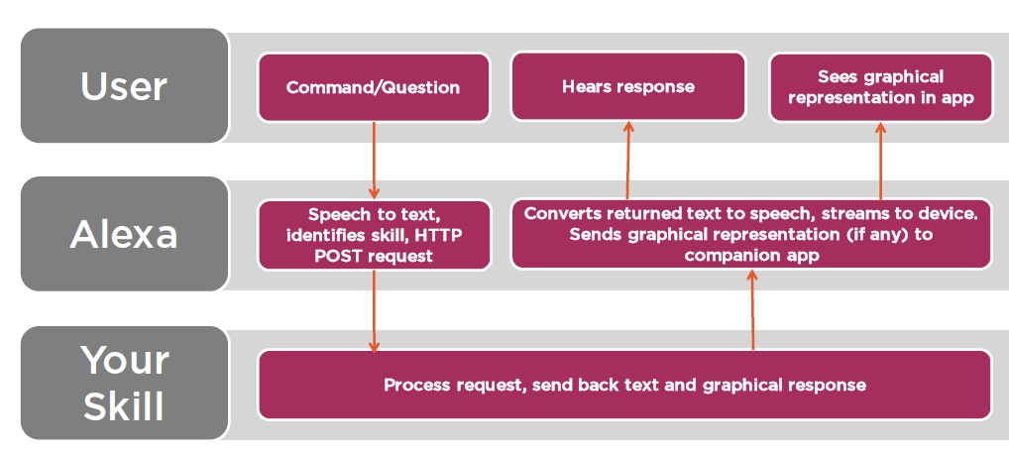
Looking at the user interaction flow*
*Stolen graciously from Walter Quesada’s course Developing Alexa Skills for Amazon Echo

Slide 16
developer prerequisites
First, create and set up an AWS (Amazon Web Services) account
To write Alexa skills with C# and Visual Studio, you’ll need to:
Download the AWS Toolkit for Visual Studio
Add your account to the AWS Explorer in Visual Studio 2015
Grab the Alexa.NET package from NuGet
All these steps are outlined in great detail in Matthias Shapiro’s blog post

Slide 17
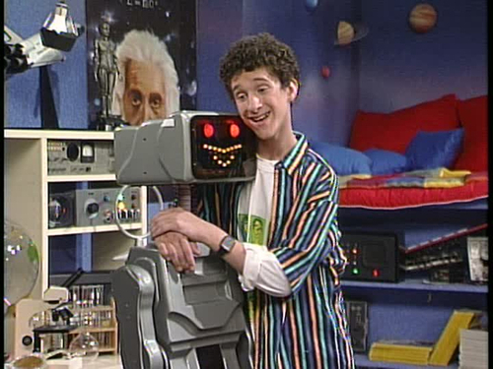
Non-developers, you’ve been warned

Slide 18

Working through the sample code

